Slide 1
Distance level monitoring using NodeMCU, Ultrasonic sensor and Blynk Server
GROUP D
Paul Macheso (219013806)
Asya suleiman mgeni (219013171)

Slide 2
PIN connection nodemcu and ultrasonic sensor
ECHO = NodeMCU D2
TRIG = NodeMCU D1
ULTRASONIC SENSOR AND POWER SUPPLY
VCC = Power Supply +5V
GND = Power Supply GND

Slide 3
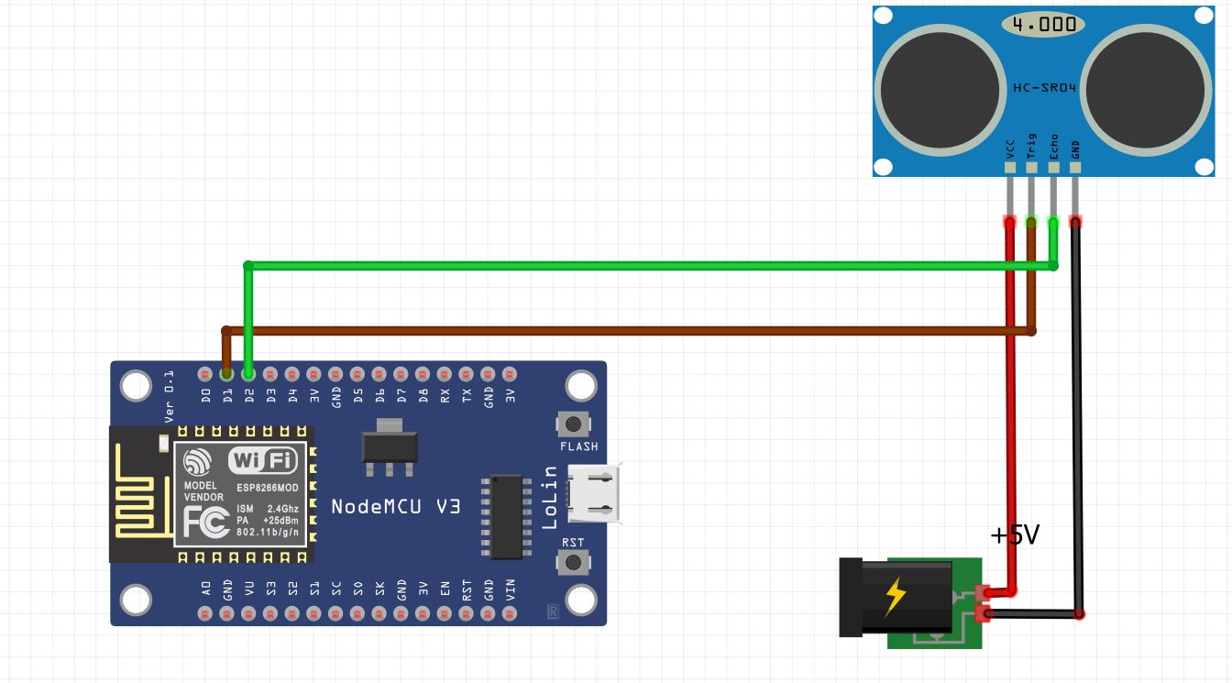
Schematic diagram

Slide 4
Code and video links
YOUTUBE LINK
https://www.youtube.com/watch?v=G4zj1gsLGwc
GITHUB LINK
https://github.com/Mbobi/Arduino

